Slide 1
Indian Food Delivery Restaurant Aggregator

Slide 2
Content
INTRODUCTION TO FOOD DELIVERY
PROBLEM STATEMENT OF THE PROJECT
TECHNOLOGIES USED IN THE PROJECT
SKILLS DEVELOPED / USED IN THE PROJECT
DATA DESCRIPTION
PROBLEM-SOLVING STEPS
TAKEAWAYS & CONCLUSIONS
FUTURE STEPS

Slide 3
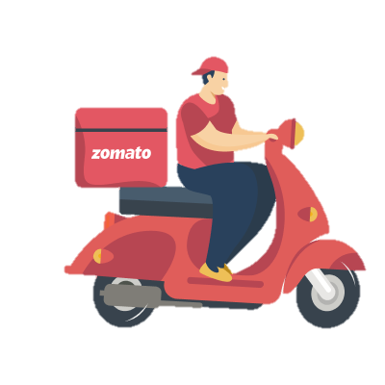
1. INTRODUCTION TO FOOD DELIVERY
People are becoming busier these days. Many industries can cash in on this opportunity.
One such growing field is food delivery space.
There are about 100k food delivery orders placed in a single day in India.
The high volume of orders require effective data handling.
A lot of insights can be derived from the enormous amount of data generated every day.

Slide 4
2. PROBLEM STATEMENT OF THE PROJECT
Bengaluru is one of the best city for food.
Increase in number of restaurants i makes it challenging for new restaurants to compete with the already-established ones.
This Zomato data tries to analyze the area's demographics.
The project will assist new restaurants in choosing their theme, menus, cuisine, price, etc. for a certain area.
Additionally, it looks for culinary similarities among Bengaluru neighbourhoods.
Finding a good restaurant at the best price is a task, and this Zomato data tries to analyze the restaurant and give the required information about it.

Slide 5

3. TECHNOLOGIES USED IN THE PROJECT
2.1 Hardware specification:
CPU: Intel i5 64-bit x86
RAM: 4 GB
Display: 1024×768
2.2 Software requirement:
Operating system: Windows 10
Python
Jupyter Notebook

Slide 6

4. SKILLS DEVELOPED / USED IN THE PROJECT
Data Definition
Data Cleaning
Data Manipulation
Logical Thinking
Insights Creation
Technical Skills - The technical skills used here are
Numpy
Pandas
Pivot tables
Group by
Matplot Lib
Sea Born

Slide 7
5. DATA DESCRIPTION
The project data has the following data fields.
Restaurant Id,Restaurant Name, Country Code, City, Address, Locality, Longitude, Latitude
Cuisines, Average Cost for two people, Price range
Has Table booking: yes/no, Has Online delivery: yes/ no, Is delivering: yes/ no, Switch to order menu: yes/no
Average rating out of 5 Votes
Out of these, cost for two people is in x,xxx form which is converted to xxxx and then to float.
Rate column was in the form x.xx/5 which was converted into x.xx and then to float.

Slide 8
6. PROBLEM-SOLVING STEPS
01
02
03
04
05
Loading CSV Data
Cleaning of Data
Data Preparation
Data Manipulation
Data Visualization
The csv file is loaded into a Dataframe using pd.read_csv
The data is checked for duplicate branches and removed using drop_duplicates()
Rate and cost have been converted into float and int values which can be used for calculations. using str.split and astype()
The data is manipulated using groupby and pivot tables to rank branches based on various factors and arithmetic operations were done on them.
The data has been visualized using charts to give visual insights on the best in various fields using sns.boxplot, sns.scatterplot, sns.barplot

Slide 9
7. TAKEAWAYS & CONCLUSIONS
While working on this project we came across the Zomato dataset with an aim to analyse the data to gain a thorough understanding of the factors influencing the establishment of all sorts of restaurants in various locations throughout Bengaluru, as well as the overall rating of each restaurant.
This makes it easier to think prior to making a dine in or online ordering.
Also Prior to making an endeavor to a small restaurant , such sort of exploration is a significant in making a call to visit or not.

Slide 10
8. FUTURE STEPS
Artificial intelligence (AI): Python can be used to analyse data and make the machine teach itself(ML) which can be used to develop many AI projects.
Big data analytics: Python is capable of handling enormous amounts of data. With TBs of data generated everyday, python is very essential in big data analytics.
Cybersecurity: The role of Python in cybersecurity is becoming increasingly vital as cyberattacks grow in number. Python's versatility and effectiveness make it indispensable for the development of advanced cybersecurity tools.
Healthcare: Python is being used to develop healthcare applications, such as predictive analytics tools for diagnosing diseases and personalized medicine. As the healthcare industry continues to adopt data science, Python will be a valuable tool for improving patient care.
Finance: Python is used in stock market predictions, analysis of company’s past performance.
Sports: Python is used in predicting sports outcome, developing chess engines, etc.

Slide 11
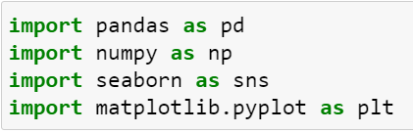
Question 1 : Loading the data set and importing all the necessary methods
Code Breakdown:
IMPORT: import statement is used to include external modules, libraries, or packages into your code
Pandas: is a Python library used for data manipulation and analysis, especially for working with structured data like tables.
Numpy: NumPy, which stands for "Numerical Python," is a fundamental Python library for numerical and mathematical operations.
Seaborn:Seaborn is a Python data visualization library based on Matplotlib that is primarily used for creating informative and attractive statistical graphics and data visualizations.
Matplotlib:Matplotlib is a widely-used Python library for creating static, animated, and interactive visualizations and plots.

Slide 12
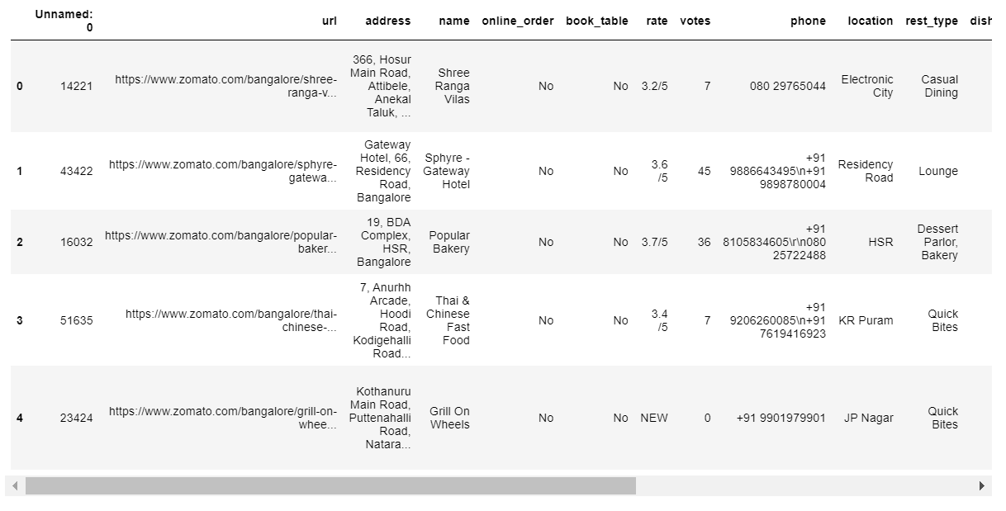
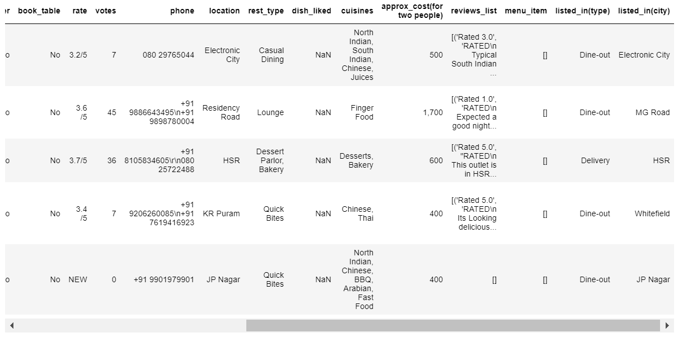
Output:

Slide 13
Question 2 :Which are the top restaurant chains based on the distribution(frequency) in Bangaluru?
Code BreakDown:
import pandas as pd imports the Pandas library into the Python environment data.
This line of code uses the value_counts() function to count the number of times each restaurant chain appears in the data DataFrame. The Restaurant Name column is used as the index for the returned DataFrame
top_chains_bangalore) prints the contents of the top_chains_bangalore variable to the console.
What did we learn from solving:
How to use the Pandas library to create and manipulate DataFrames.How to use the value_counts() function to count the number of occurrences of each unique value in a Series or DataFrame.How to print the contents of a variable to the console.

Slide 14
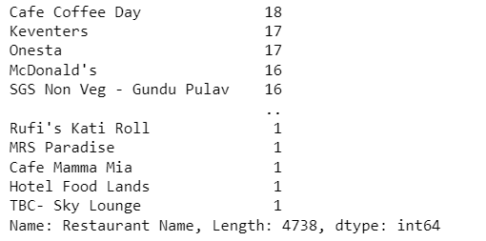
Output:

Slide 15
Question 3: Restaurants not accepting online orders
Code Breakdown:
The first line imports the Pandas library.It creates a dictionary called data with two keys: Restaurant Name and online_order. The values for the Restaurant Name key are the names of five restaurants, and the values for the online_order key are whether or not each restaurant accepts online orders.It creates a Pandas DataFrame called df from the data dictionary.It uses the loc method to select the rows in df where the value in the online_order column is equal to No.It uses the count() method to count the number of rows that are selected.It prints the result of the count() method
What did we learn from solving:
How to use the Pandas library to read and manipulate data.
How to use the loc method to select rows in a Pandas DataFrame.
How to use the count() method to count the number of rows in a Pandas DataFrame.

Slide 16
Output:
4057
Heads Up on the answer received:

Slide 17
Question 4: Ratio of restaurants providing table booking
Code Breakdown: first imports the pandas library. This library is used for data analysis and manipulation.Next, the code creates a DataFrame object called data. This object contains a single column called book_table. The values in this column are either Yes or No.The next line of code creates a new object called ratio_table_booking. This object is a value_counts object, which is used to count the number of occurrences of each value in a column. The normalize=True parameter tells the value_counts function to return the relative frequencies of the values, rather than the absolute frequencies.The final line of code prints the ratio_table_booking object.
What did we learn from solving:
First, we learn how to use the pandas library to analyze data. Second,
we learn how to use the value_counts function to count the number of occurrences of each value in a column. Finally, we learn how to use the normalize=True parameter to return the relative frequencies of the values.

Slide 18
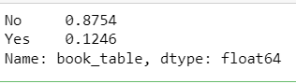
Output:
HeadsUp on the Output received:

Slide 19
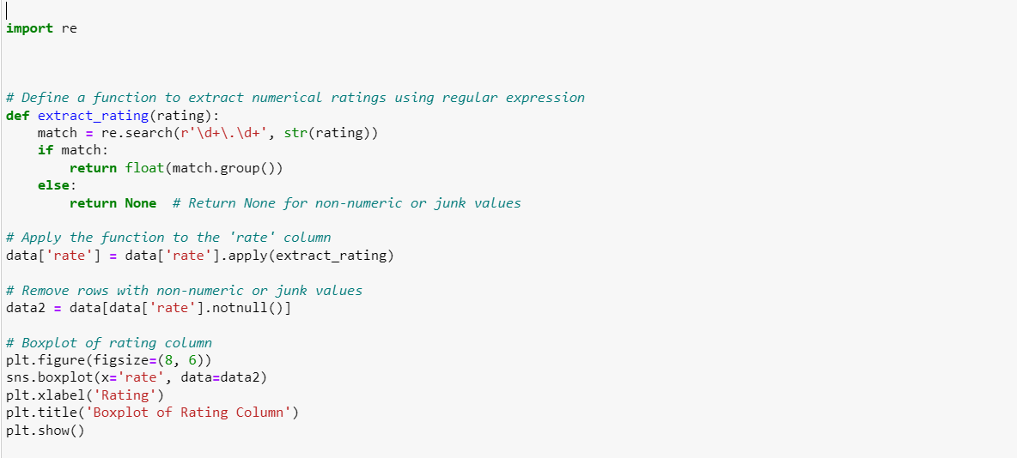
Question 5:

Slide 20
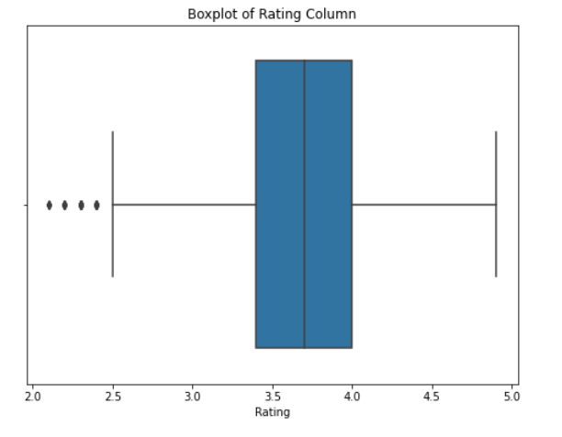
Output:
Code Breakdown: The first line imports the regular expression library. The second line defines a function called extract_rating(). This function takes a rating as input and returns a float if the rating is a number, or None if the rating is not a number.The third line applies the extract_rating() function to the rate column of the data dataframe.The fourth line removes the rows from the data dataframe where the rate column is None.The fifth line creates a boxplot of the rate column of the data2 dataframe. The sixth line labels the x-axis and the title of the plot.The seventh line shows the plot.
What have we learnt from the problem:Regular expressions can be used to extract numerical values from text.
The apply() function can be used to apply a function to all the elements of a column in a dataframe.
The notnull() function can be used to select rows from a dataframe where a particular column is not None.
The boxplot() function can be used to visualize the distribution of values in a column.

Slide 21
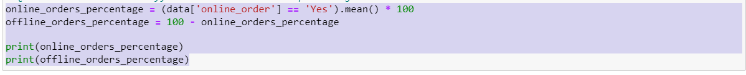
Question 6:Online and Offline orders restaurant percentage
Code Break down:Line 1: Import the pandas library.
Line 2: Create a dictionary called data with the key online_order and the values ['Yes', 'No', 'Yes', 'No', 'Yes'].
Line 3: Create a Pandas DataFrame called df from the dictionary data.
Line 4: Calculate the percentage of online orders by using the mean() method on the df['online_order'] == 'Yes' series and multiplying the result by 100.
Line 5: Calculate the percentage of offline orders by subtracting the percentage of online orders from 100.
Line 6: Print the results of the calculations.
What we have learnt by solving this problem:How to calculate the percentage of online orders in a Pandas DataFrame.How to subtract two numbers in Python.How to print the results of a calculation in Python.

Slide 22
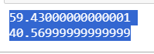
Output:
A heads Up on the output obtained:It shows that 60% of the orders in this dataset are online orders and 40% are offline orders. This information could be useful for a business that wants to understand its customers' buying habits and make decisions about how to allocate resources.

Slide 23
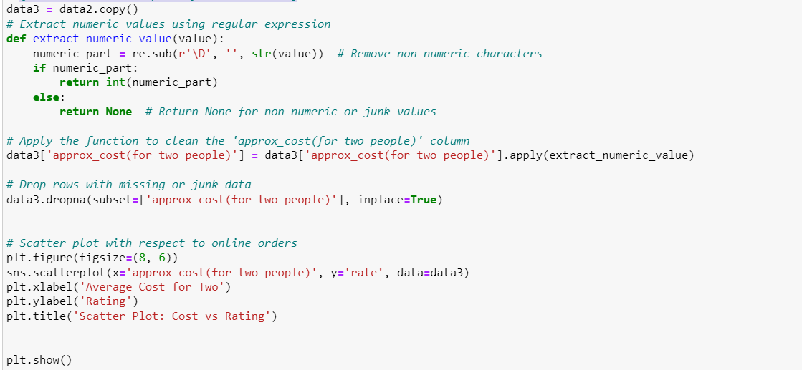
Question 7: Scatter plot of Cost vs Rating

Slide 24
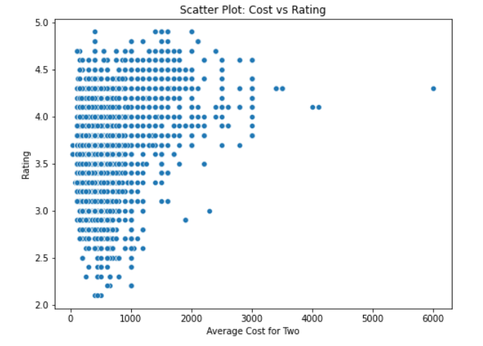
Output:
Code Break down:The first line creates a copy of the data2 dataframe and assigns it to the data3 variable. This is done to avoid overwriting the original data.The second line defines a function called extract_numeric_value(). This function takes a string as input and returns an integer if the string only contains numeric characters. Otherwise, the function returns None.The third line applies the extract_numeric_value() function to the approx_cost (for two people) column of the data3 dataframe. This replaces all non-numeric characters in the column with empty strings.The fourth line drops any rows in the data3 dataframe that have missing or invalid values in the approx_cost (for two people) column.The fifth line creates a scatter plot of the approx_cost(for two people) and rate columns of the data3 dataframe.The sixth line labels the x-axis and y-axis of the scatter plot.The seventh line titles the scatter plot.The eighth line displays the scatter plot.
What we have learnt from solving this problem: Regular expressions can be used to extract numeric values from strings.It is important to clean data before performing any analysis.Scatter plots can be used to visualize the relationship between two variables.

Slide 25
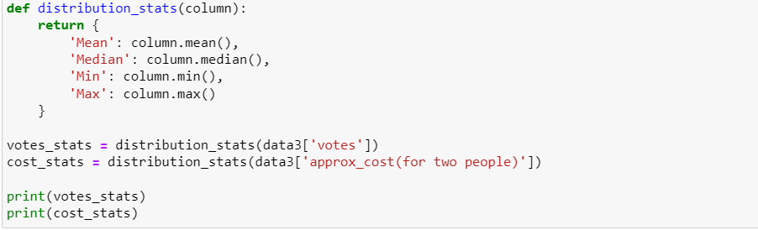
Question 8: Distribution of votes and Approx_cost

Slide 26
Output:
Code Break down:
The first function, distribution_stats(), takes a column of data as input and returns a dictionary of descriptive statistics for that column, including the mean, median, minimum, and maximum values. The second function, votes_stats(), calls the distribution_stats() function to calculate the descriptive statistics for the votes column in the data dataframe. The third function, cost_stats(), does the same thing for the approx_cost (for two people)column. Finally, the last two lines of code print the results of the votes_stats() and cost_stats() functions.
What we have learnt from the problem:
How to calculate descriptive statistics for a column of dataHow to use functions to modularize codeHow to print the results of a functionThis is a simple example, but it can be used as a starting point for more complex problems. For example, we could extend this code to calculate descriptive statistics for multiple columns, or to plot the distribution of the data.

Slide 27
Question 9: Most common restaurant type in Bangalore
Code Break down:
import pandas as pd: This imports the pandas library, which is used to read and manipulate DataFrames.data = pd.DataFrame({'rest_type'}): This creates a DataFrame called data with one column called rest_type. The rest_type column contains a list of three restaurant types, each separated by a comma.common_restaurant_types = data['rest_type'].str.split(',', expand=True) . stack() . value_counts(): This calculates the most common restaurant types in the data DataFrame. The str.split() function splits the rest_type column into a list of individual restaurant types. The expand=True argument ensures that each restaurant type is a separate column in the resulting DataFrame. The stack() function collapses the DataFrame by stacking the values of each column on top of each other. This creates a new column called level_1 which contains the restaurant types, and a new column called values which contains the number of times each restaurant type appears. The value_counts() function is then used to count the number of times each restaurant type appears in the values column.print(common_restaurant_types): This prints the results of the common_restaurant_types calculation to the console.
What we have learnt from the problem:
we learn how to use the str.split() function to split a string into separate columns.
Finally, we learn how to use the stack() and value_counts() functions to count the number of occurrences of each value in a column.

Slide 28
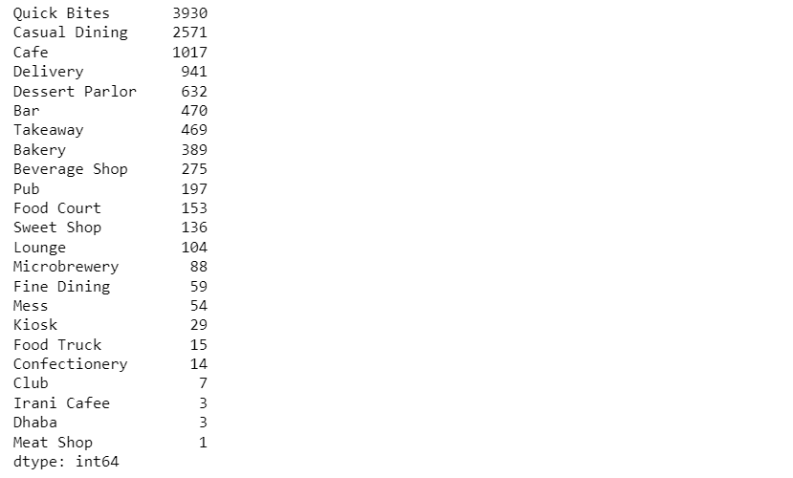
Output:

Slide 29
Question 10: Difference in votes for restaurants accepting and not accepting online orders
Code Break down:
The first line imports the pandas library, which is a Python library for data analysis.The second line creates a Pandas DataFrame called data. The DataFrame contains two columns: online_order and votes. The online_order column indicates whether the order was placed online or offline. The votes column indicates the number of votes for the order.The third line creates a variable called votes_difference. This variable will store the average number of votes for each online order and offline order.The fourth line uses the groupby() method to group the DataFrame by the online_order column. The mean() method then calculates the mean of the votes column for each group.The fifth line prints the value of the votes_difference variable.
What we have learnt from the problem:
he groupby() method is a powerful tool for grouping data and performing aggregations.The mean() method is used to calculate the mean of a column.The print() method is used to print the value of a variable.

Slide 30
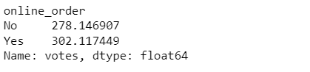
Output:
Heads Up on the output received:
This output shows that the average number of votes for online orders is 302 and the average number of votes for offline orders is 278

Slide 31
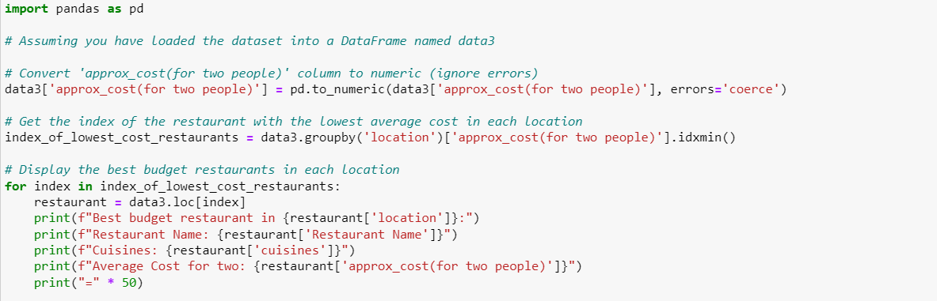
Question 12:

Slide 32
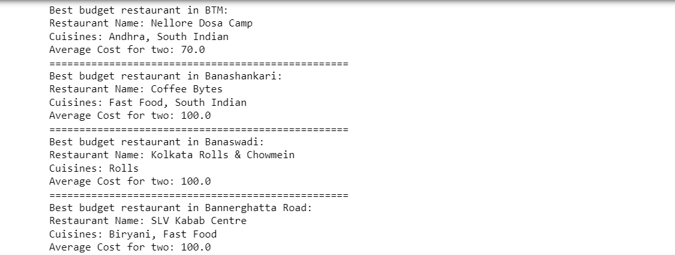
Output:

Slide 33
Code Break down:
This line of code converts the approx_cost (for two people) column in the data3 DataFrame to numeric data type. The errors='coerce' argument tells pandas to ignore any rows where the value cannot be converted to numeric data type.This line of code gets the index of the restaurant with the lowest average cost in each location. The groupby() function groups the rows in the data3 DataFrame by the location column and then takes the minimum value of the approx_cost(for two people) column in each group. The idxmin() function returns the index of the minimum value in each group.This line of code iterates through the index_of_lowest_cost_restaurants list and prints the details of the best budget restaurant in each location. The loc() function is used to select the row at the specified index in the data3 DataFrame.
What we have learnt from the problem:
How to convert a column of data to numeric data type.How to group data by a column and find the minimum value in each group.How to iterate through a list and print the details of each item in the list.

Slide 34
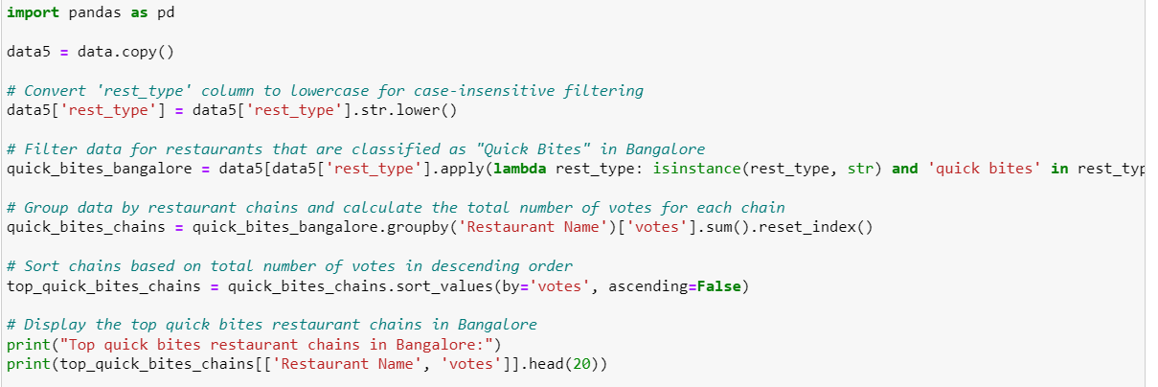
Question 13:

Slide 35
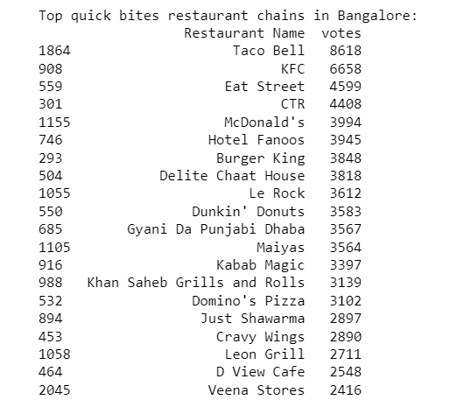
Output:
Code Break down:
This line of code converts the rest_type column in the data5 DataFrame to lowercase. This is done so that we can perform case-insensitive filtering on the column.This line of code filters the data for restaurants that are classified as "Quick Bites" in Bangalore. The apply() function is used to apply a function to each row in the rest_type column. The function checks if the value in the row is a string and if the string contains the substring "quick bites". If it does, the row is included in the filtered DataFrame.This line of code groups the data by restaurant chains and calculates the total number of votes for each chain. The groupby() function groups the rows in the quick_bites_bangalore DataFrame by the Restaurant Name column and then sums the values in the votes column for each group. The reset_index() function resets the index of the DataFrame so that the index is the Restaurant Name columnThis line of code sorts the quick_bites_chains DataFrame by the votes column in descending order. This means that the chains with the most votes will be at the top of the DataFrame.This line of code prints the top 20 restaurant chains in the top_quick_bites_chains DataFrame.
What we have learnt from the problem:
How to filter data based on a condition.
How to group data by a column and calculate a summary statistic.
How to sort data by a column.
How to print the top n rows of a DataFrame.

Slide 36


